Slide 1
Engaging students with case studies
Seacrest Fellowship Findings
Lunch & Learn
College of Business, University of Nebraska - Lincoln
October 20, 2023
Robert Mackalski | Kasey Linde | David Keck | Seth Polsley
Notes:
We’re here today to go over the early findings from research,
I cant begin without giving a major tip of the hat to Kasey, Dave, Seth who have contributed to this research.

Slide 2
Agenda
Motivation
Study
Findings
Conclusion

Slide 3
Case Studies in the College of Business
If you were selecting a case study for your class, what would you look for? Why?

Slide 4
MOTIVATION

Slide 5
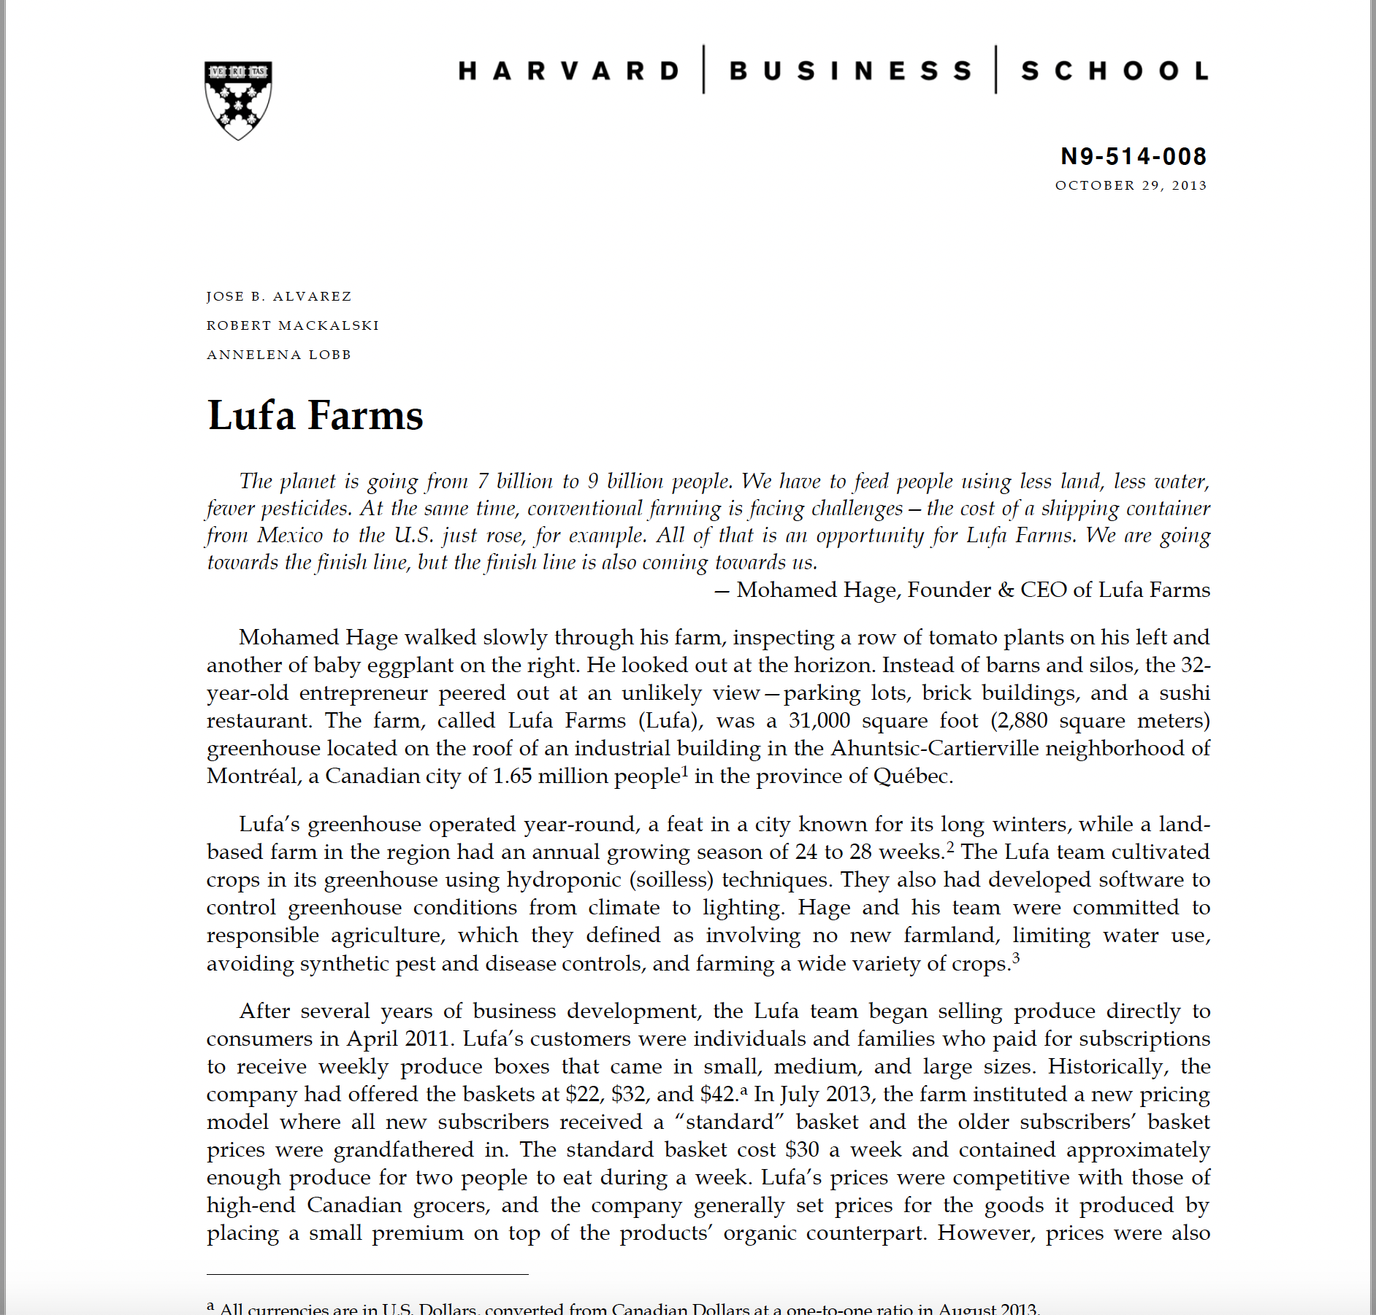
MOTIVATION

Slide 6
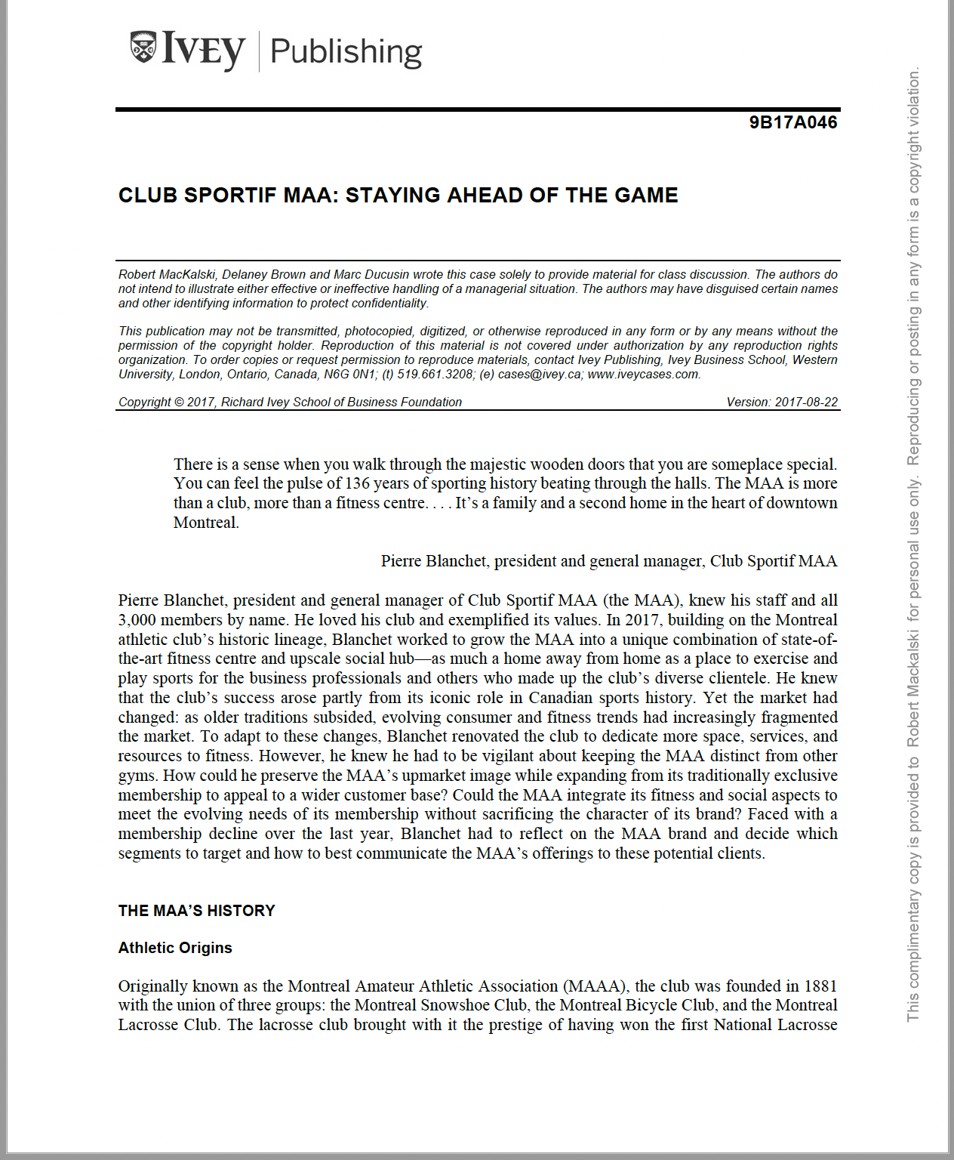
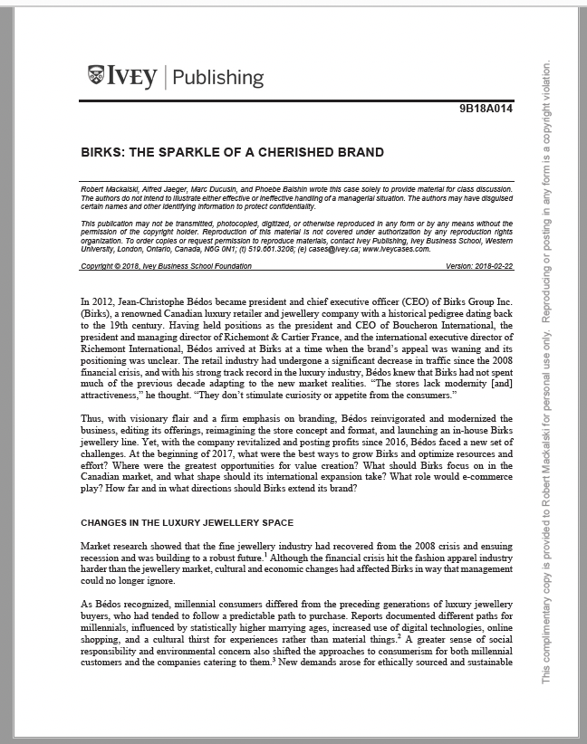
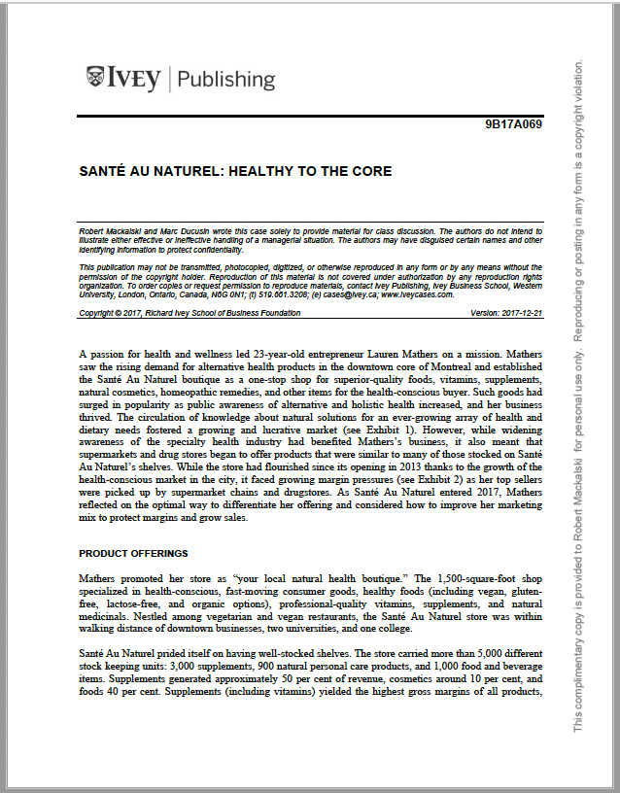
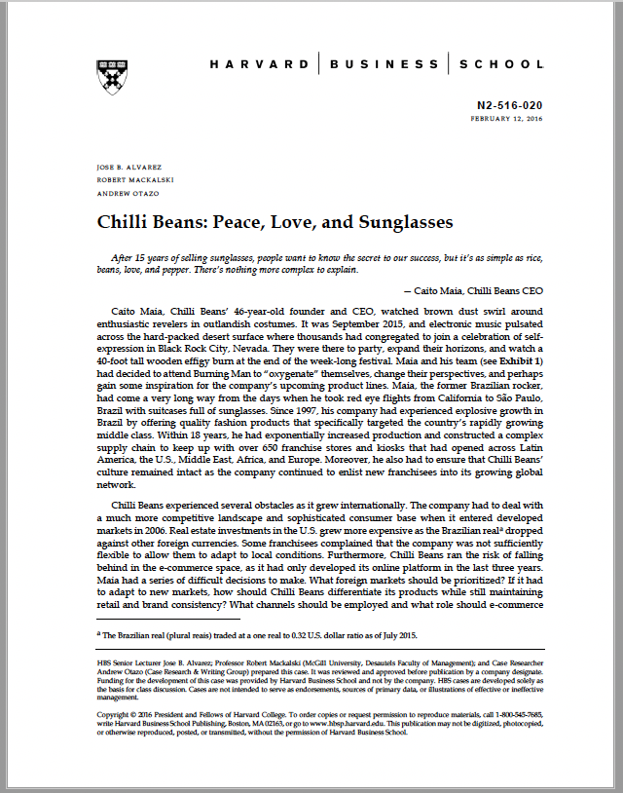
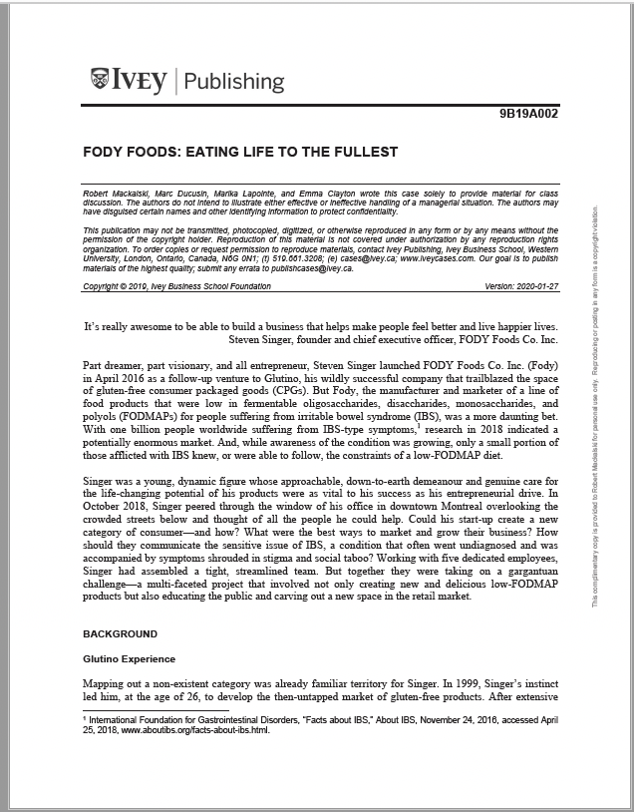
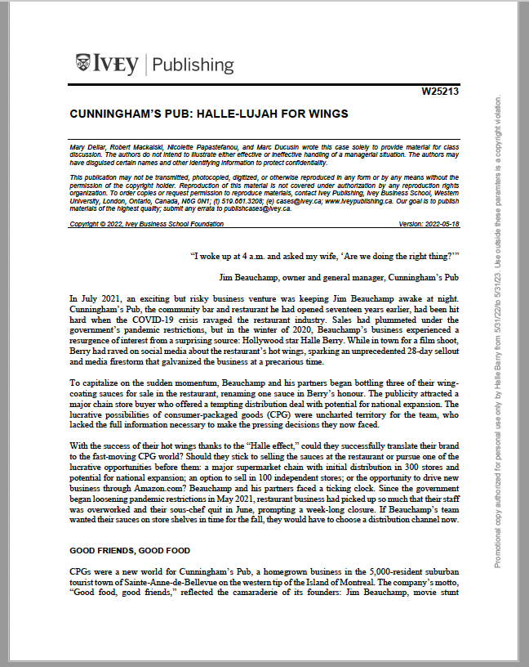
MOTIVATION

Slide 7
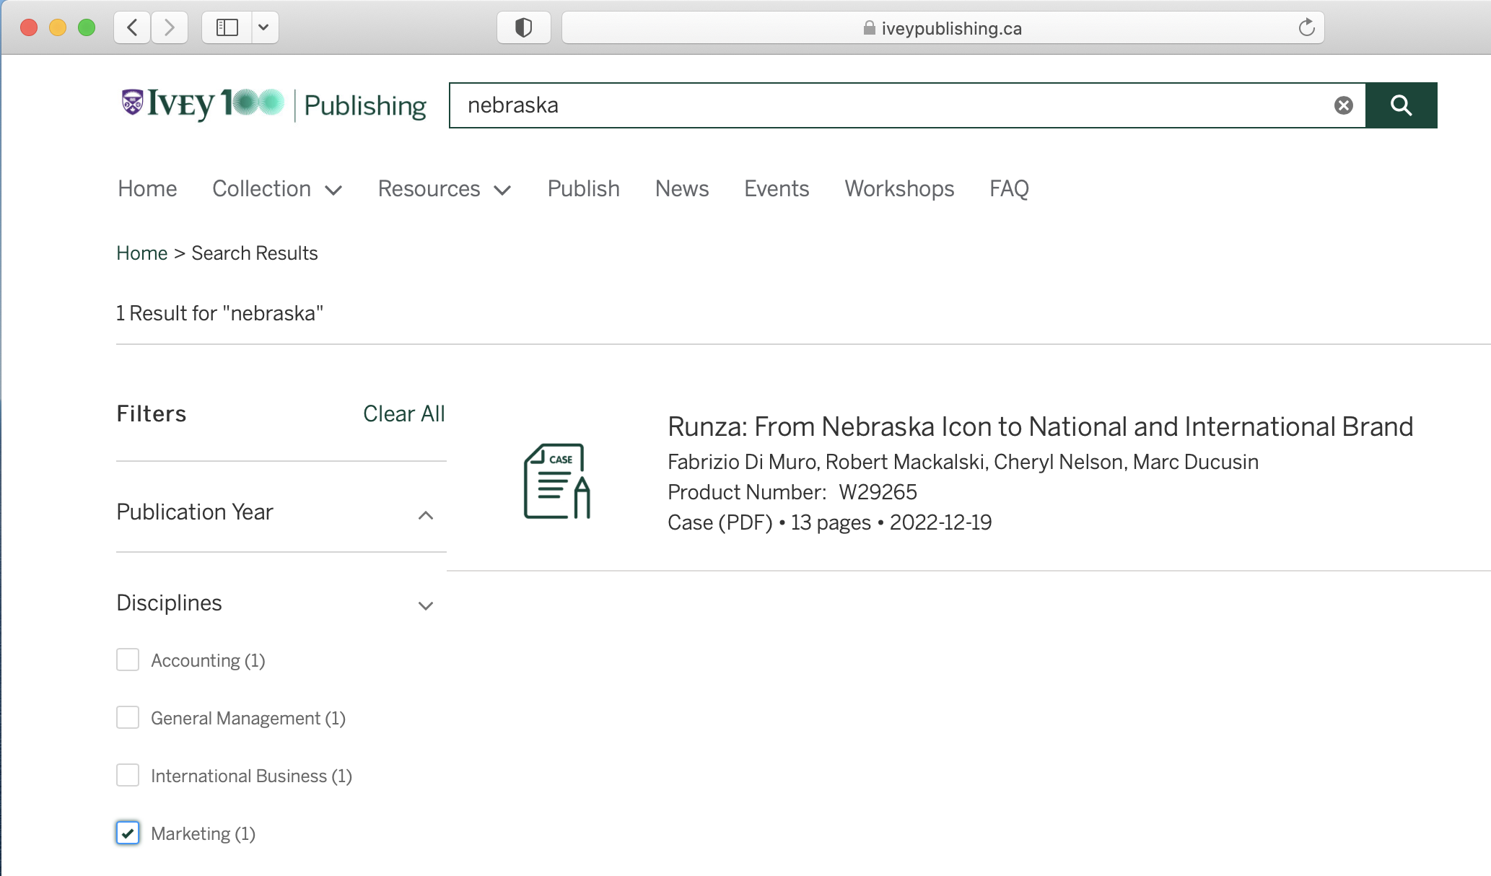
MOTIVATION
0

Slide 8
MOTIVATION

Slide 9
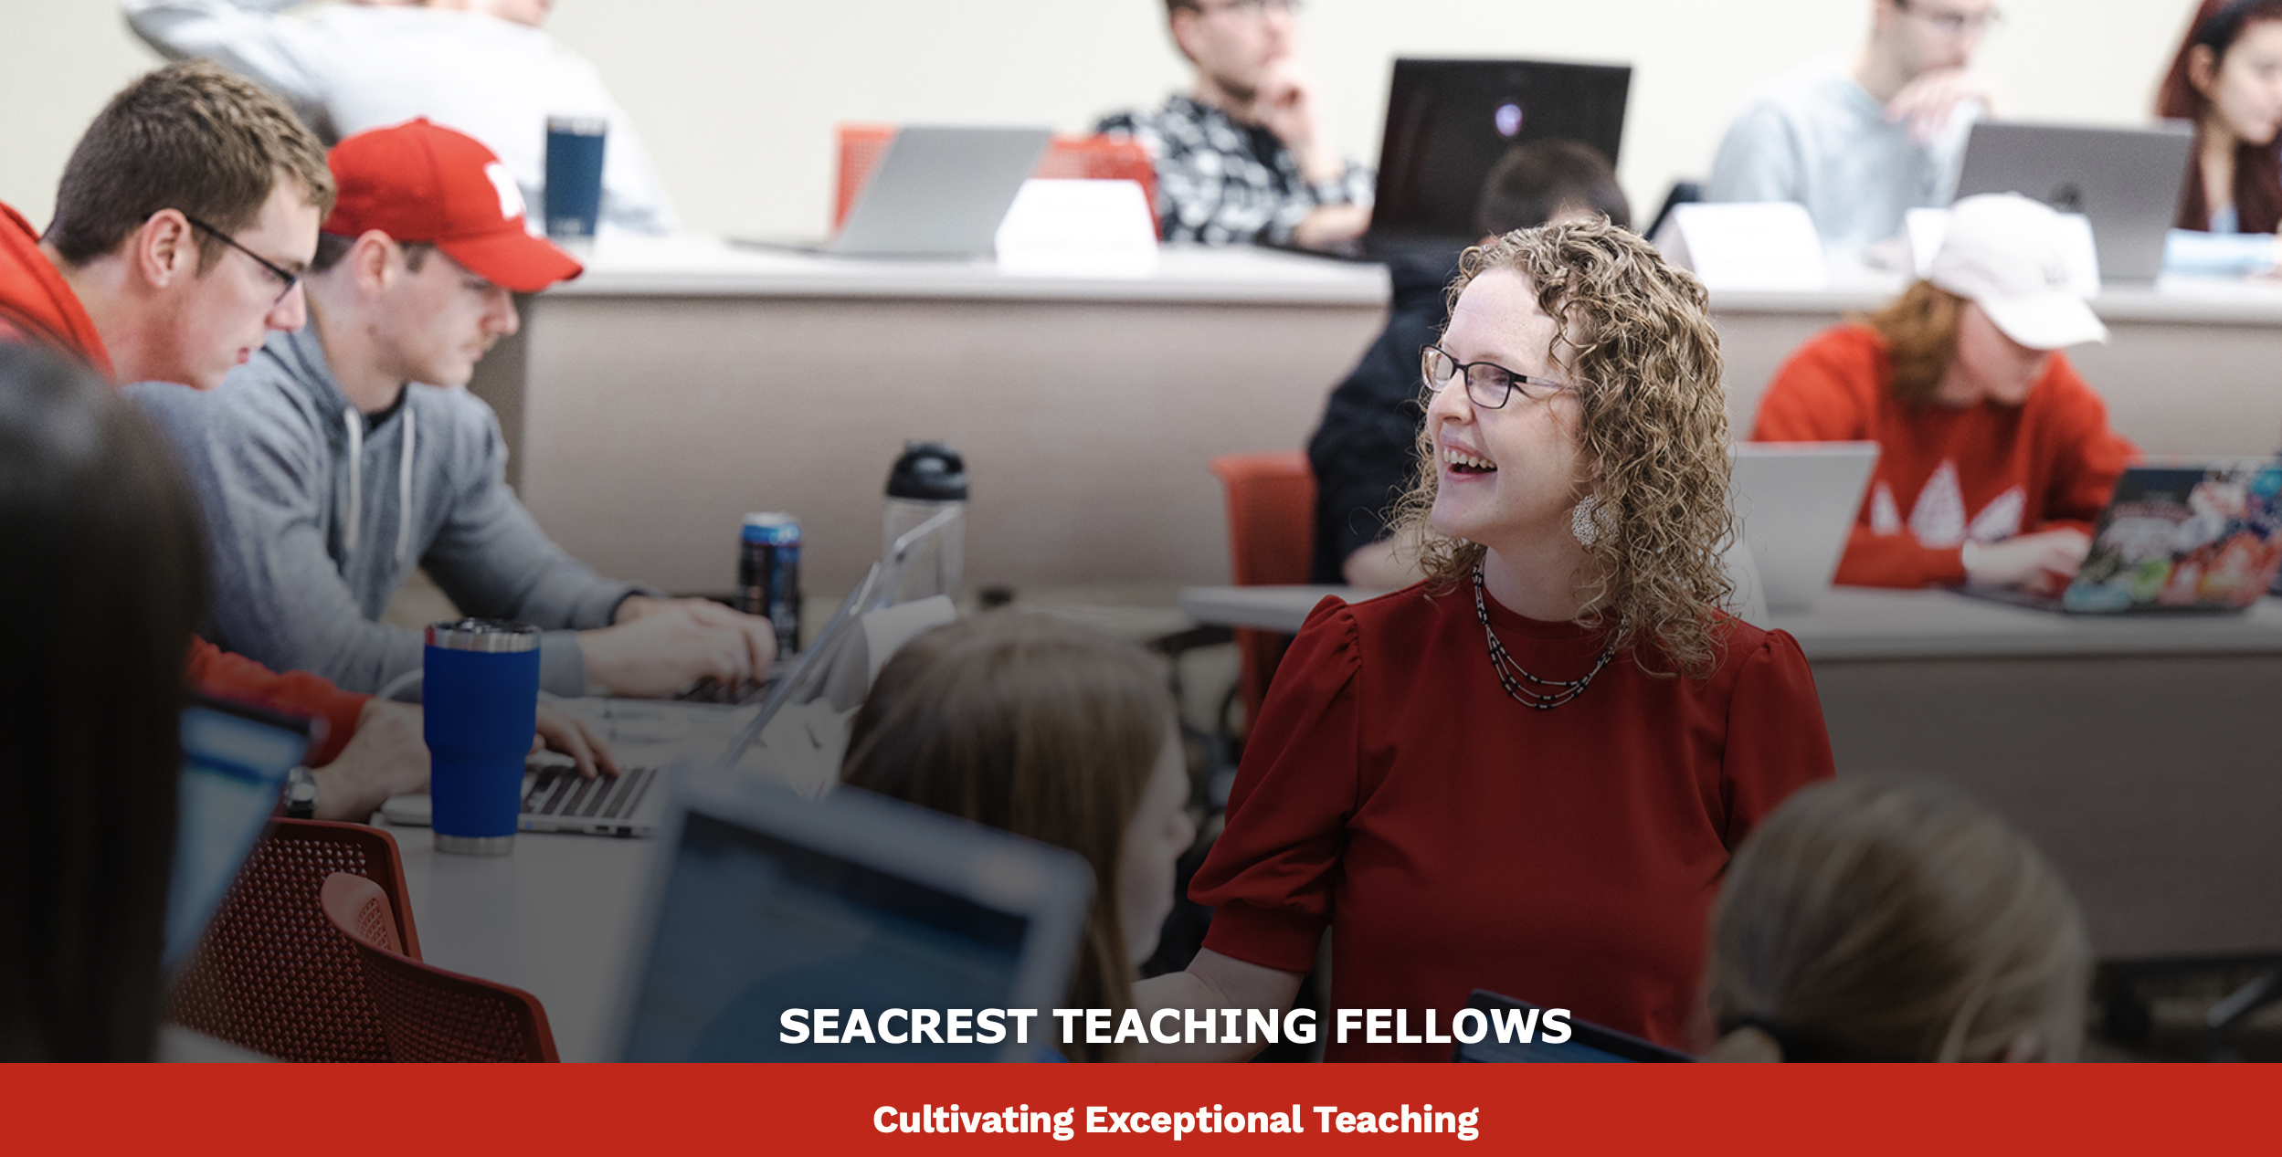
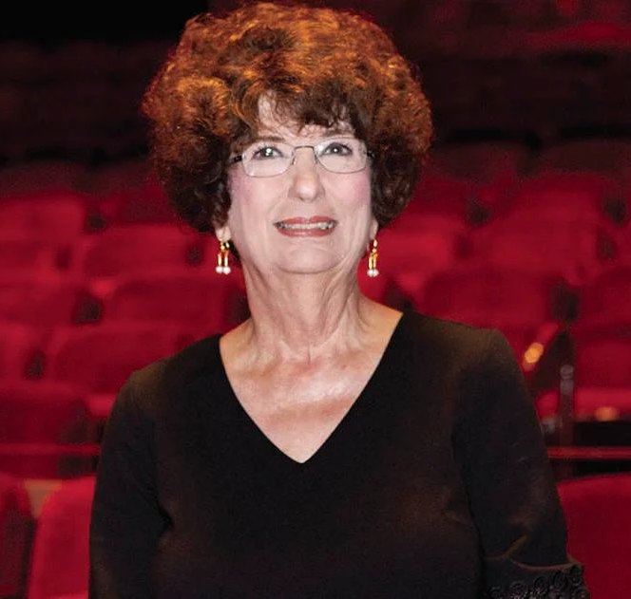
MOTIVATION

Slide 10
RESEARCH QUESTION
What is the impact on student engagement when students study an in-state, high-brand-equity company in a case study?

Slide 11
RESEARCH QUESTION
What is the impact on student engagement when students study an in-state, high-brand-equity company in a case study?

Slide 12
RESEARCH QUESTION
What is the impact on student engagement when students study an in-state, high-brand-equity company in a case study?
Astin, A.W. (1984) Student Involvement: A Developmental Theory for Higher Education. Journal of College Student Development. 25, pp. 297–308.
Kahu, Ella R. "Framing student engagement in higher education." Studies in higher education 38.5 (2013): 758-773.
Oana, L. U. P., and Elena Cristina Mitrea. "Online learning during the pandemic: Assessing disparities in student engagement in higher education." Journal of Pedagogy 1 (2021): 31-50.
Wang, Ming‐Te, and Jessica Degol. "Staying engaged: Knowledge and research needs in student engagement." Child development perspectives 8.3 (2014): 137-143.
Engagement is an antecedent to learning and favorable student outcomes.

Slide 13
THE STUDY

Slide 14
THE STUDY
Students in MRKT 341(Spring 2023) class had an individual case study assignment to submit to Canvas.
Notes:
There is an assignment – part of the 250 student class
133 students agreed to participate in a study where they would answer a questionnaire and we could collect data on their case work.

Slide 15
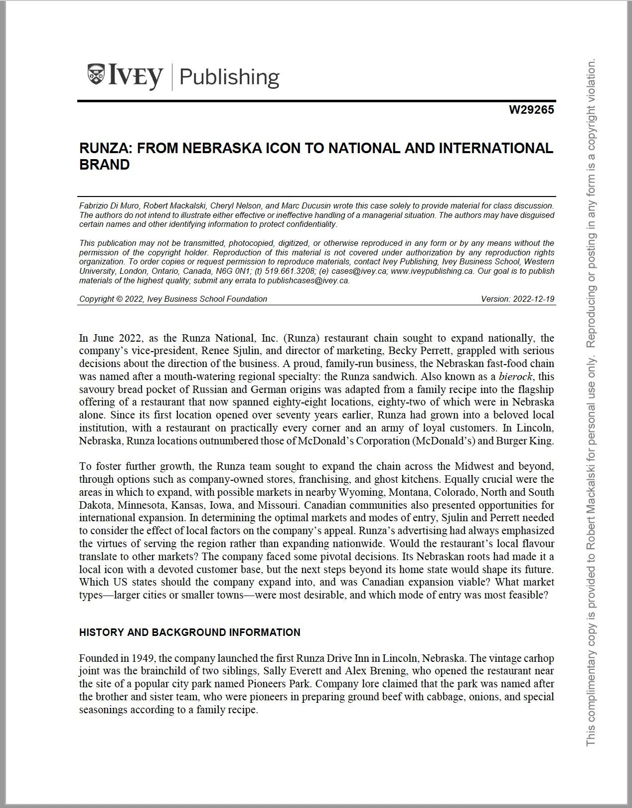
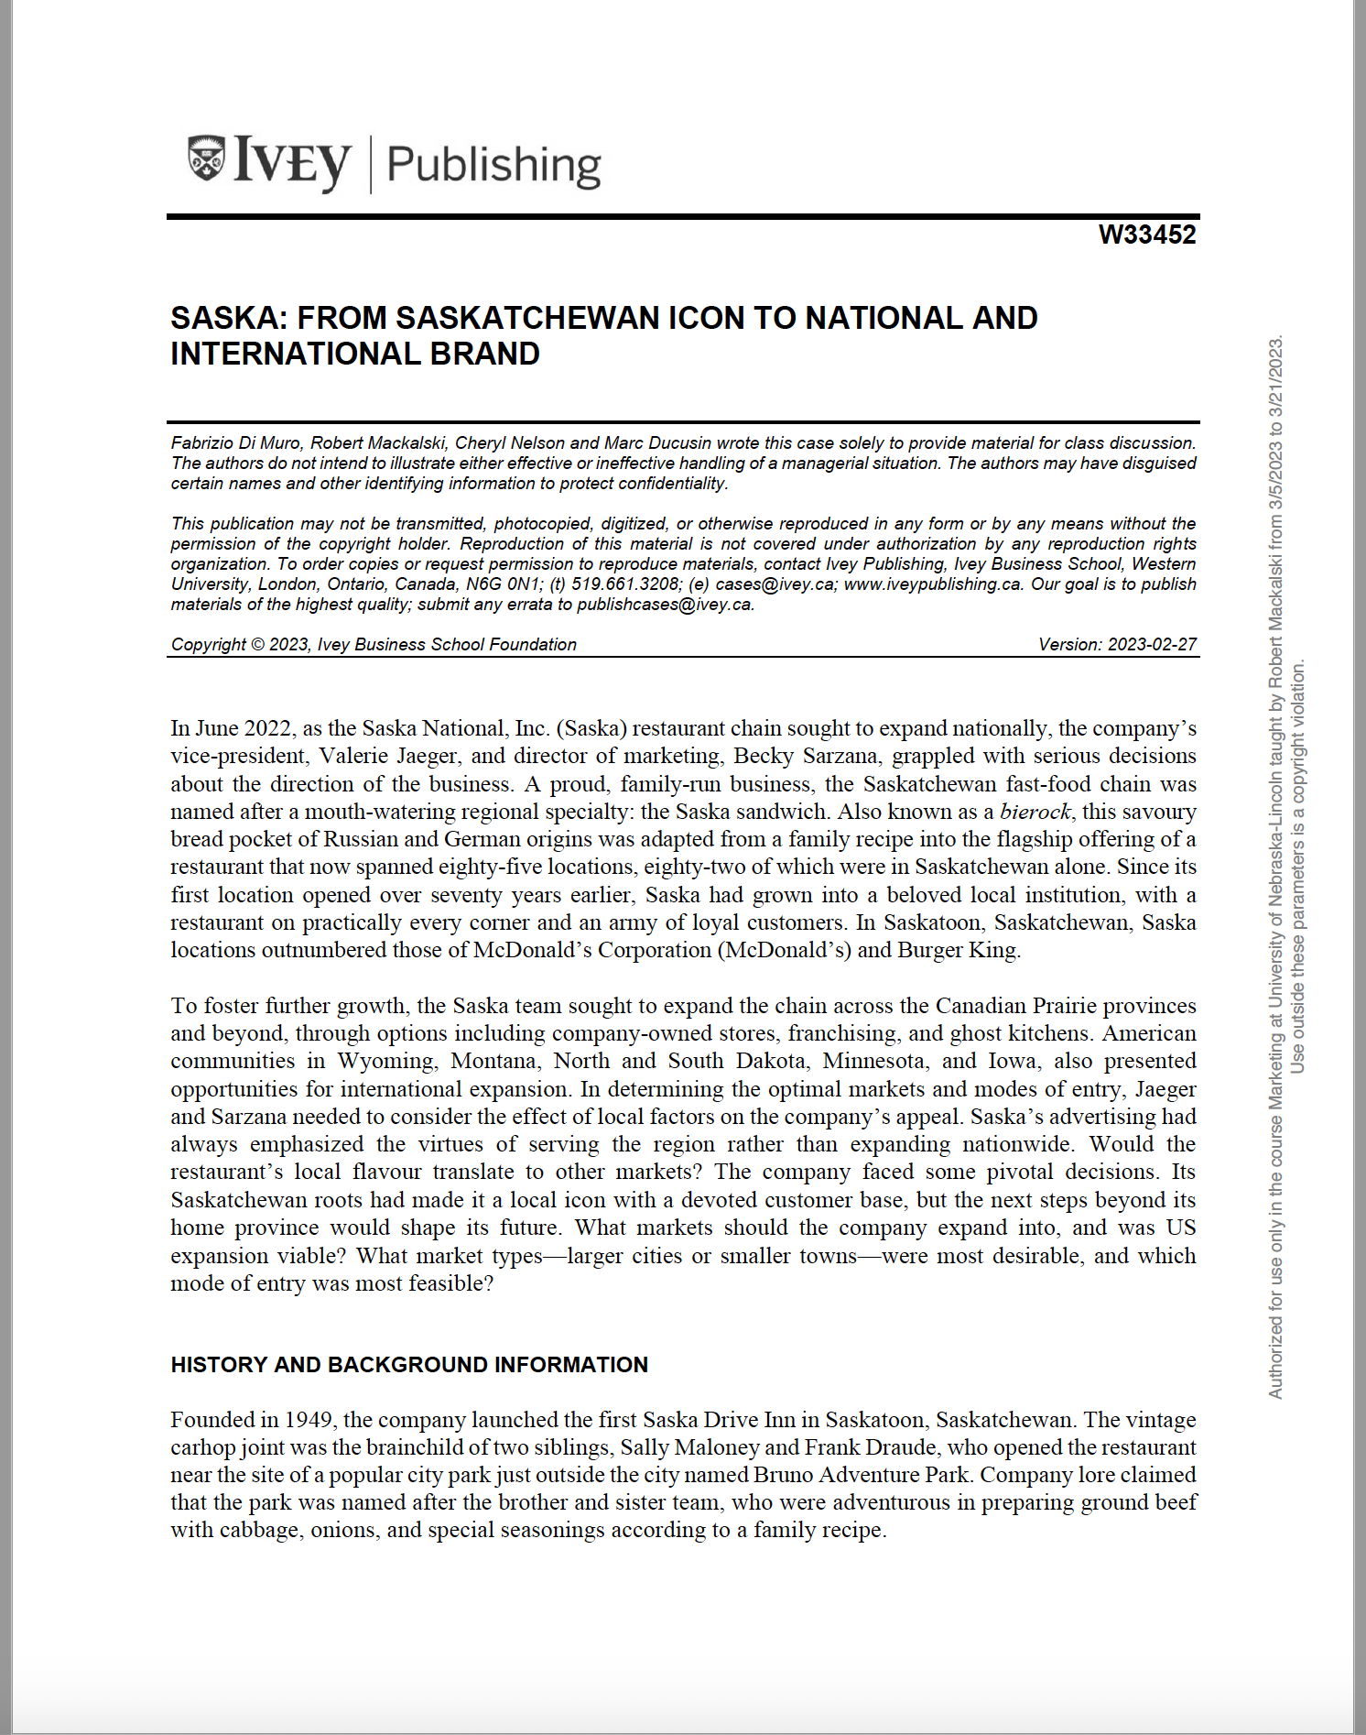
THE STUDY
Students in MRKT 341 were randomly assigned one of two cases: Runza or Saska.
Notes:
There is an assignment – part of the 250 student class
133 students agreed to participate in a study where they would answer a questionnaire and we could collect data on their case work.

Slide 16
THE STUDY
113 students agreed to participate in a study where they would answer a questionnaire and we could collect data from their case work.
Questionnaire
Assignment
Augmented data
N=66
N=67
Notes:
There is an assignment – part of the 250 student class
133 students agreed to participate in a study where they would answer a questionnaire and we could collect data on their case work.

Slide 17
THE STUDY > Questionnaire
Brand knowledge (Keller, 1993)
Net Promoter Score (Reicheld, 2003)
Overall Brand Equity (Yoo and Donthu, 2001)
Lovers vs Haters (Mackalski, 2014)
Interest in the case
Level of Nebraskaness

Slide 18
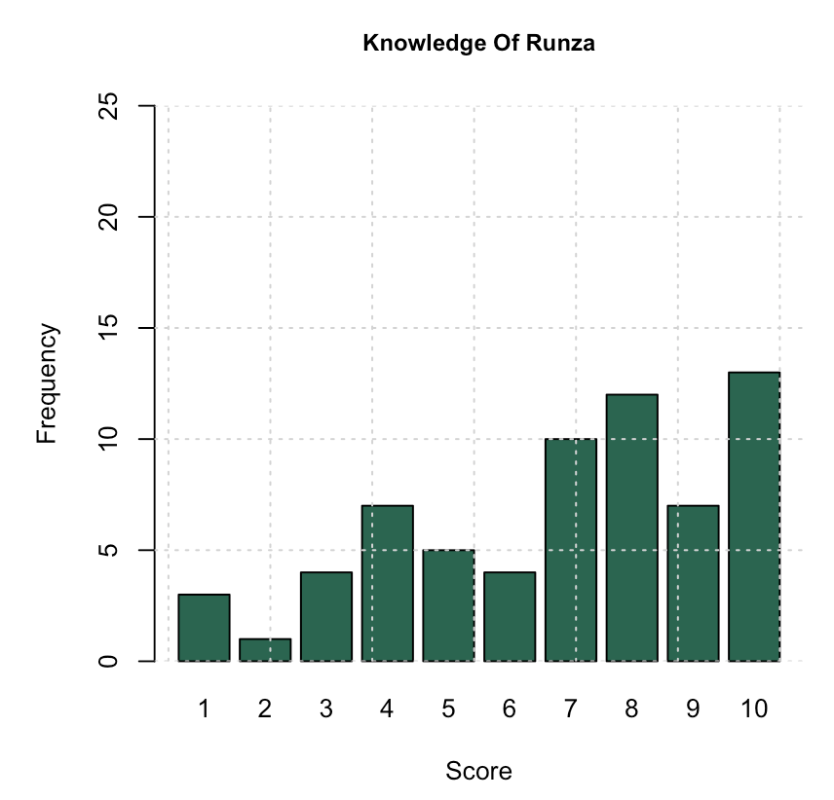
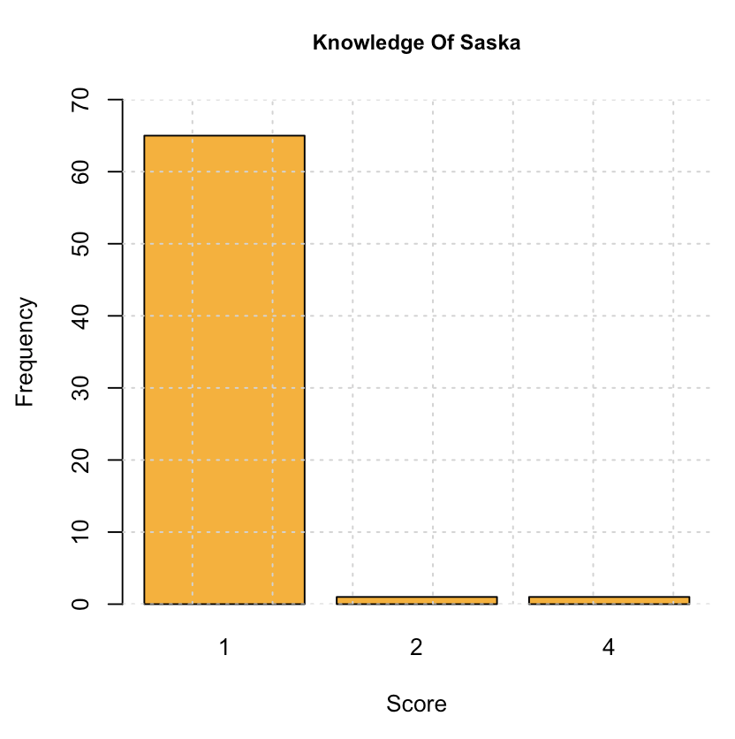
THE STUDY > Questionnaire > Brand Knowledge
Keller, Kevin Lane. "Conceptualizing, measuring, and managing customer-based brand equity." Journal of marketing57.1 (1993): 1-22

Slide 19
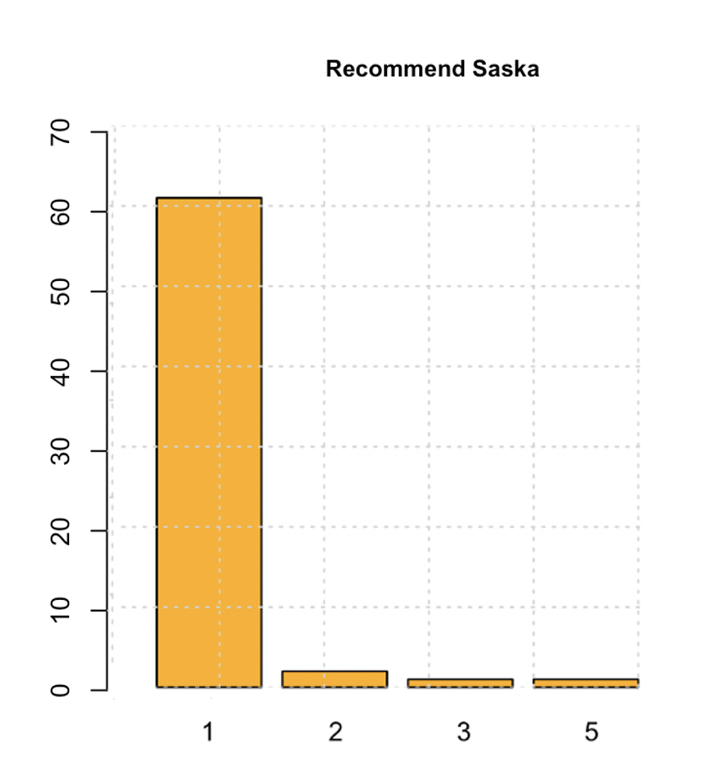
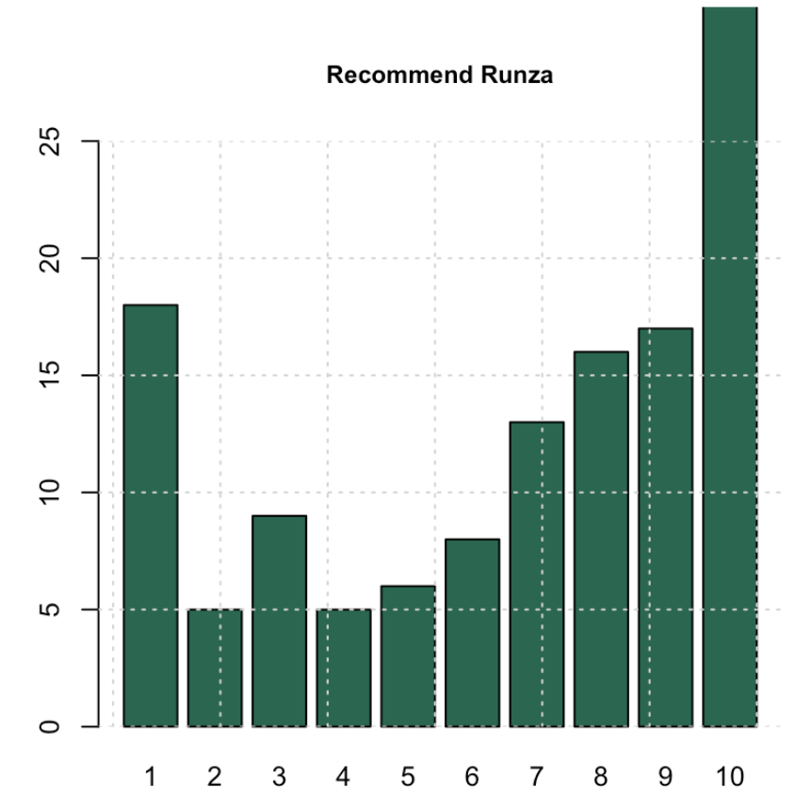
THE STUDY > Questionnaire > Net Promoter Score

Slide 20
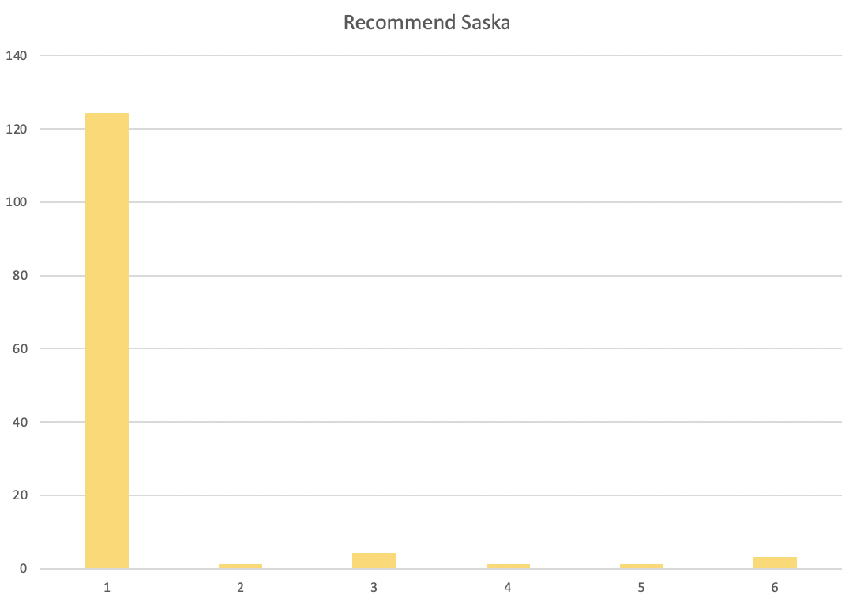
THE STUDY > Questionnaire > Net Promoter

Slide 21
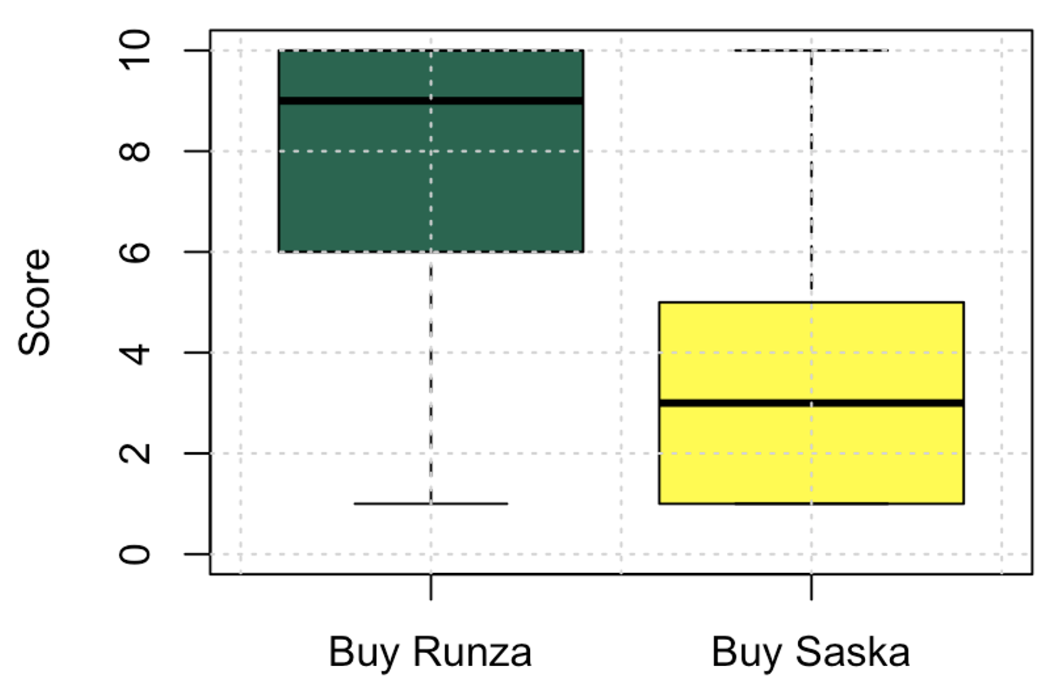
THE STUDY > Questionnaire > Overall Brand Equity
Yoo, Boonghee and Naveen Donthu (2001),“Developing and Validating a Multidimensional Consumer‐Based Brand Equity Scale, Journal of Business Research, 52,1-.‐14.

Slide 22
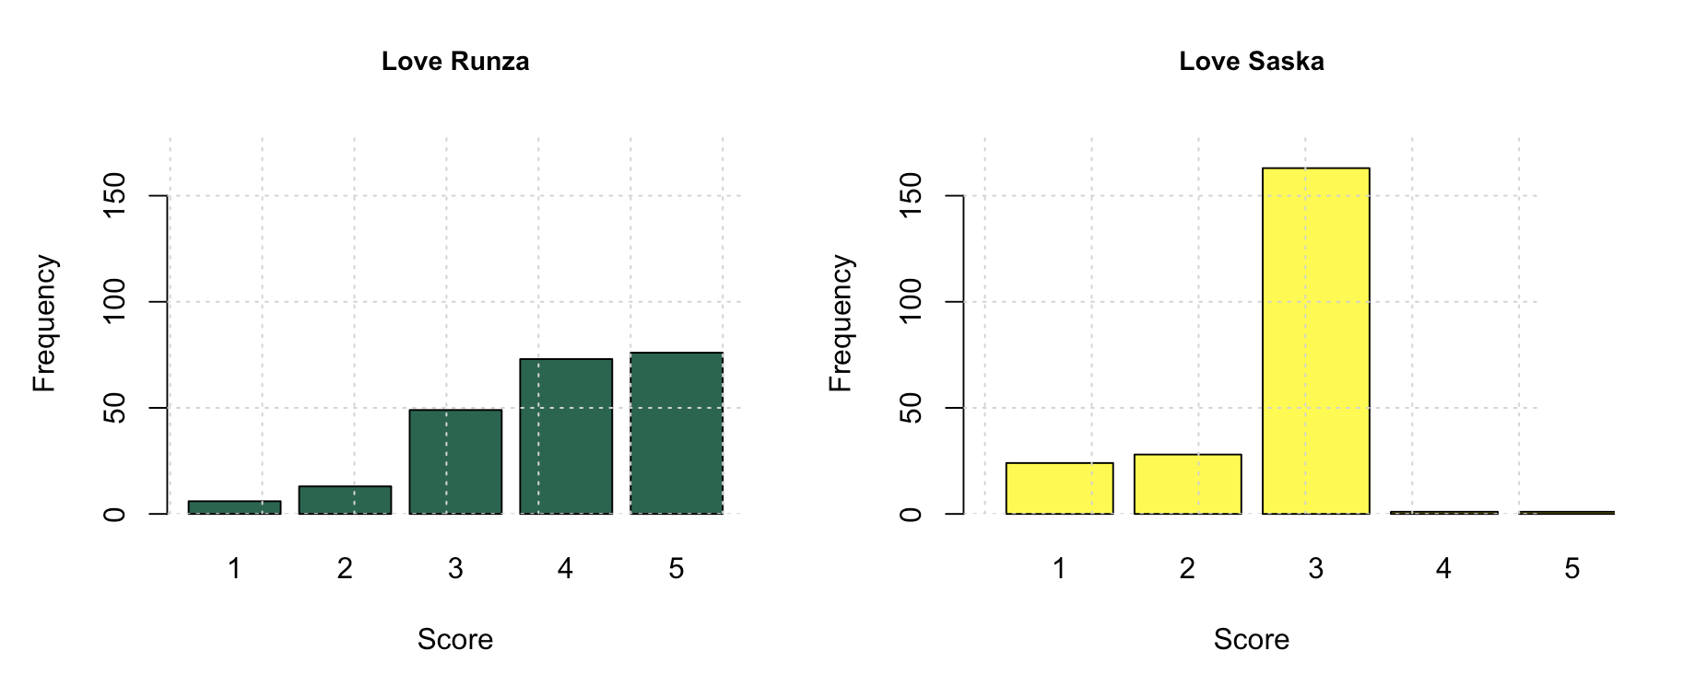
THE STUDY > Questionnaire > Lovers vs Haters
Mackalski, Robert. The state and the union of brand measurement. Diss. McGill University, 2014.

Slide 23
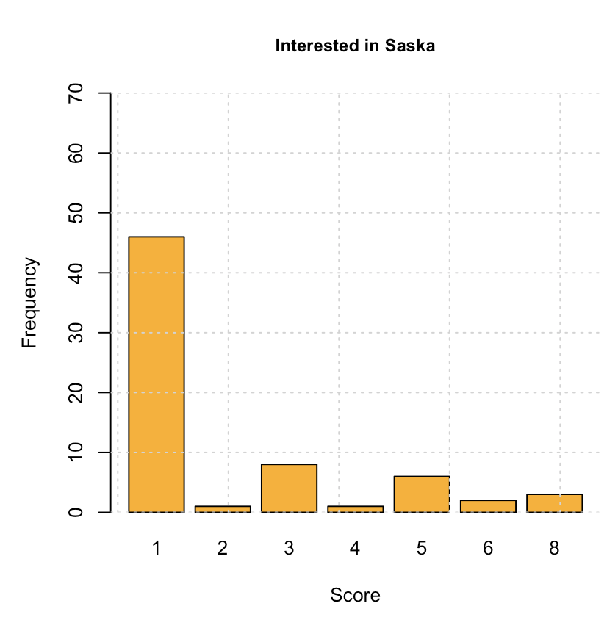
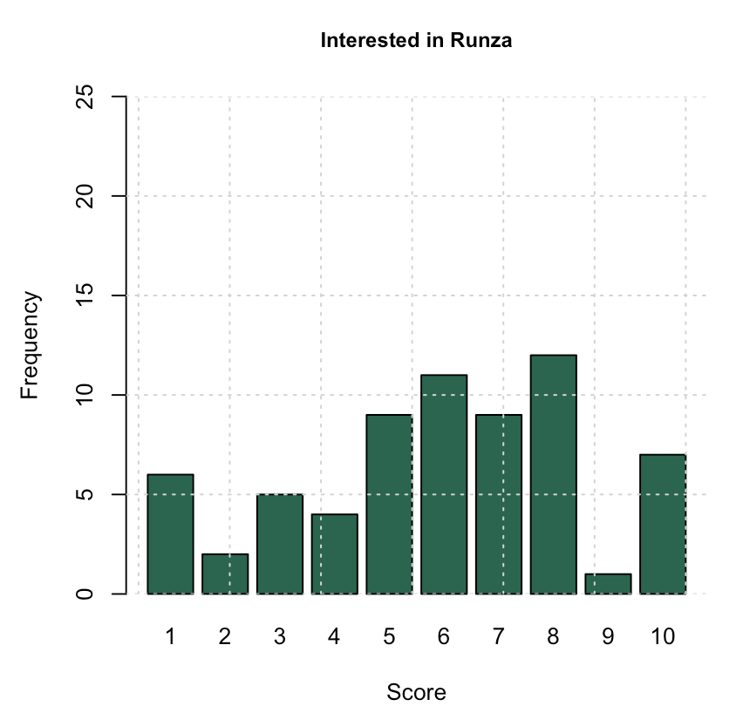
THE STUDY > Questionnaire > Interest

Slide 24
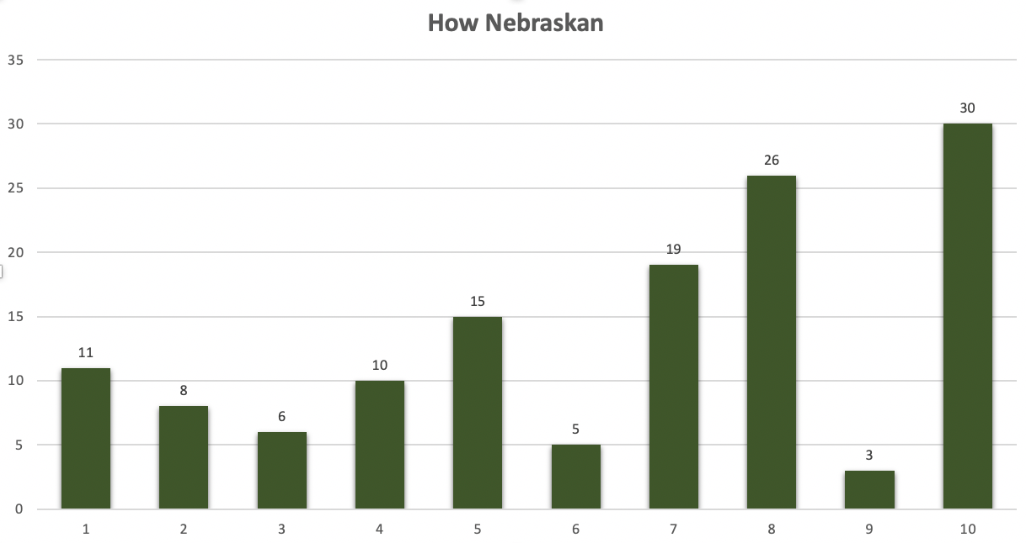
THE STUDY > Questionnaire > Nebraskaness
N=133

Slide 25
THE STUDY > Correlation > Nebraskaness + love
Nebraskans are more in love with Runza than non- Nebraskans
P= 0.0000000002
There is a moderate positive correlation how Nebraskan one feels and the love of Runza. R² = .57
Notes:
Runza clearly has an audience in Nebraskans
Two tail unequal variance

Slide 26
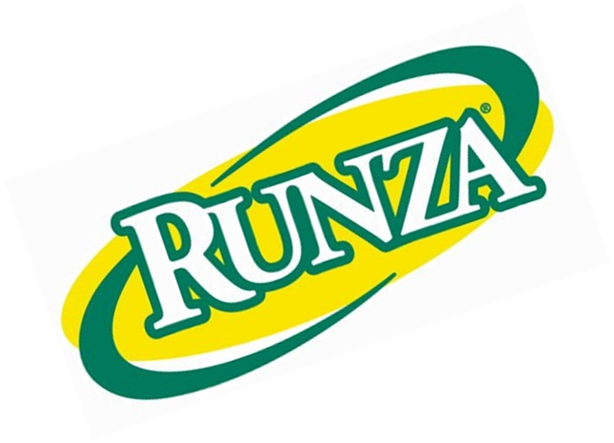
THE STUDY > Correlation > knowledge + love
There is a strong positive correlation between awareness of Runza and the love of Runza.
R² = .76
Notes:
Runza clearly has an audience in Nebraskans
Two tail unequal variance

Slide 27
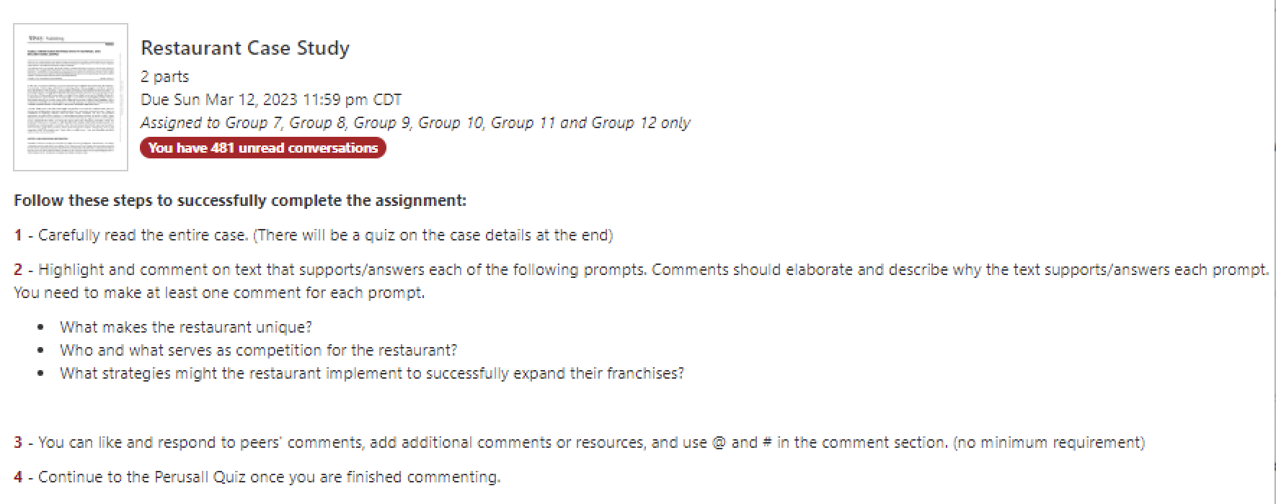
THE STUDY > Assignment
Number of words per student
Number of annotations per student
Time engaging with the case
Notes:
Number of words – total number of comments
Number of annotations
Time engaging with the case-

Slide 28
THE STUDY > Augmented Data
GPA
First Generation
Home state
Major
Minor
Ethnicity
Gender

Slide 29
FINDINGS

Slide 30
FINDINGS
Students who studied the Runza case had higher engagement.
The higher engagement is not evenly dispersed; some segments see the greater engagement lift.

Slide 31
FINDINGS
Students who studied the Runza case had higher engagement.
The higher engagement is not evenly dispersed; some segments see the greater engagement lift.

Slide 32
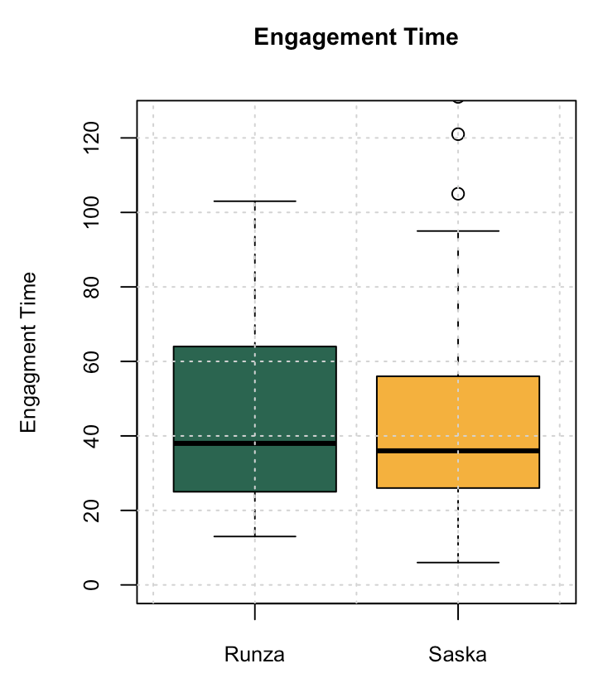
FINDINGS > overall class
The same amount of engagement time was spent on both cases.
(p=.95)

Slide 33
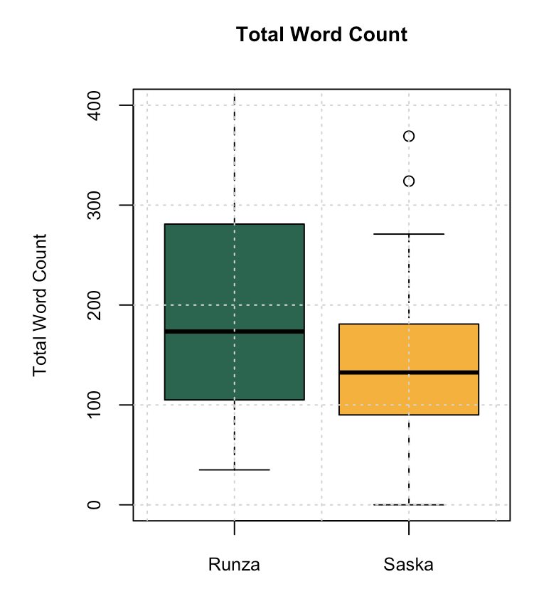
FINDINGS > overall class
Students wrote 38% more on the Runza case.
(p=.027)

Slide 34
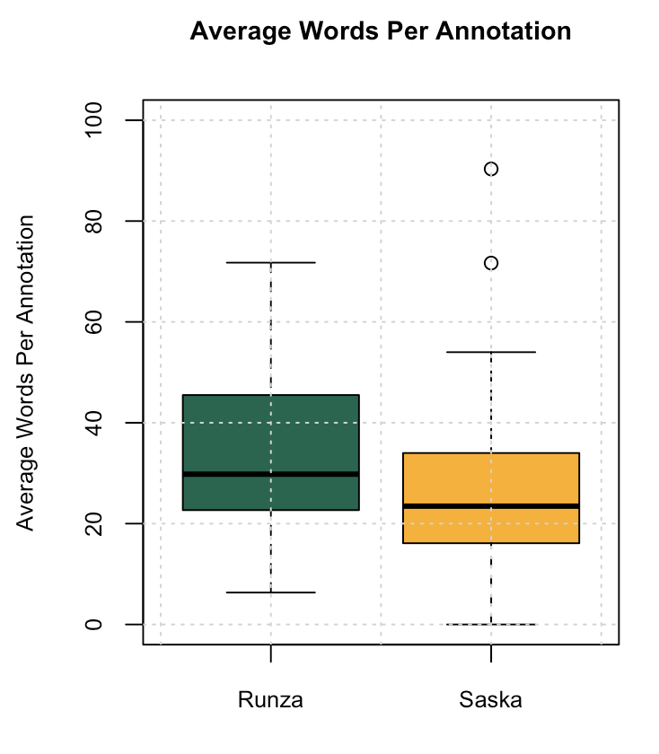
FINDINGS > overall class
Students wrote 29% more per comment on the Runza case.
(p=.015)

Slide 35
FINDINGS
Students who had studied the Runza case had higher engagement.
The higher engagement is not evenly dispersed; some segments see the greater engagement lift.

Slide 36
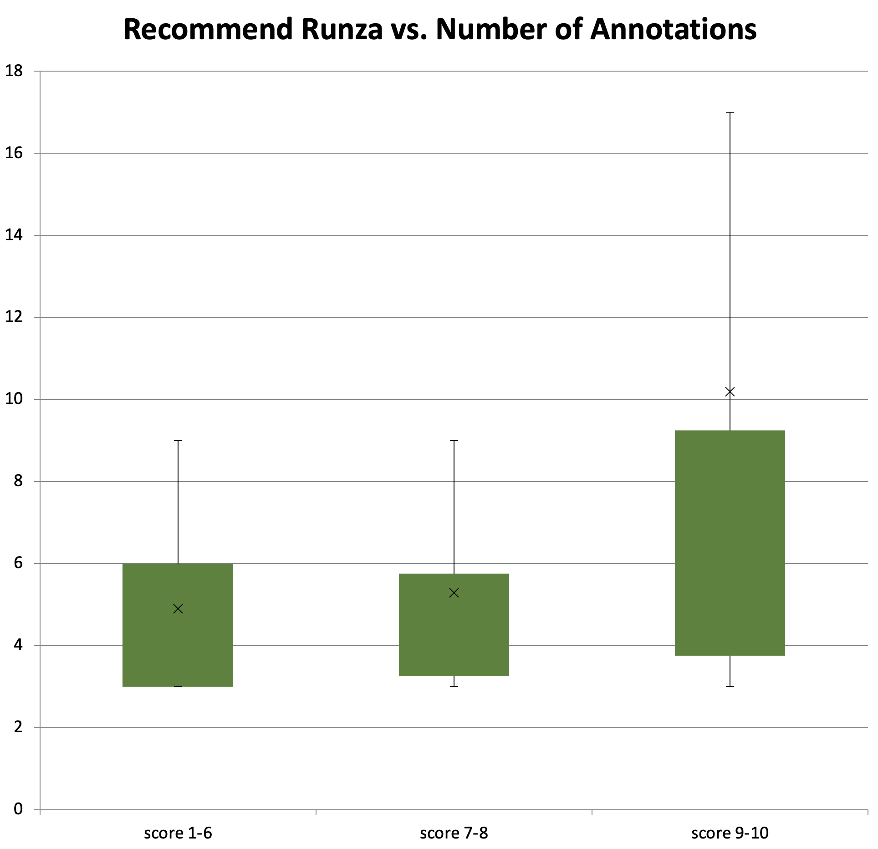
FINDINGS > NPS impact on number of comments
“Promoters” make more comments than “detractors”
(p = 0.02)
“Promoters” make more comments than “Passives”
(p = 0.03)
N=20
N=32

Slide 37
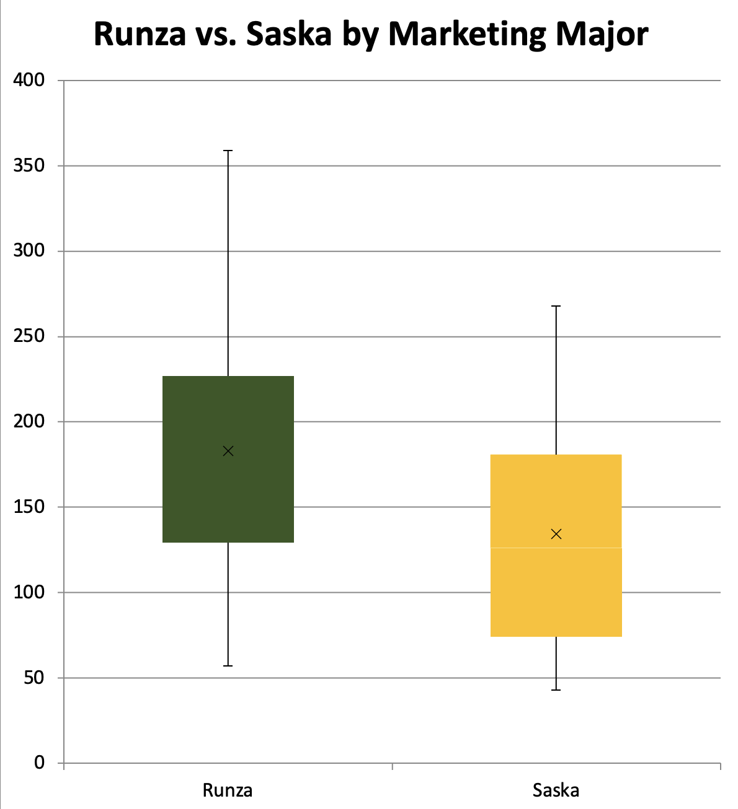
FINDINGS > Major impact on word count
Marketing majors wrote 37% more when studying Runza.
(p = 0.04)
Non-marketing majors wrote 38% more when studying Runza. (p = 0.035)
Notes:
First gen vs non in Runza <not enough data… forced a t test> based on small sample. DF are 5 or 6 not enough
1 tail welches t test
Marketing marjor R
Means marketing majors: 183. Saska 134.47
Menas non marjo 223 vs 162

Slide 38
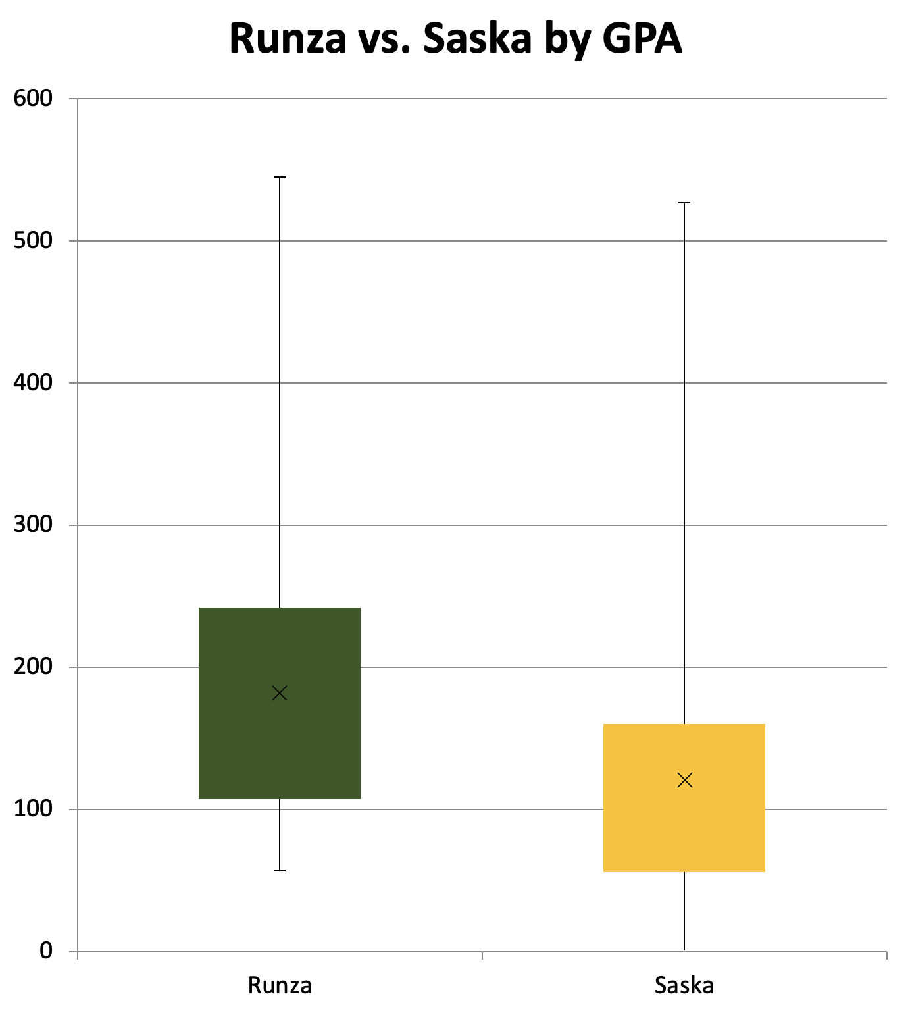
FINDINGS > GPA impact on word count
The biggest impact was seen with students in the 3.0-3.49 GPA range.
These “B” students wrote 50% more when studying Runza. (p = 0.05)
Notes:
Welches ttest
1 tail

Slide 39
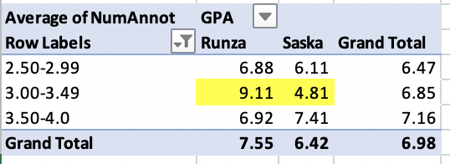
FINDINGS > GPA number of comments
The number of comments doubled on the Runza case for the B students.

Slide 40
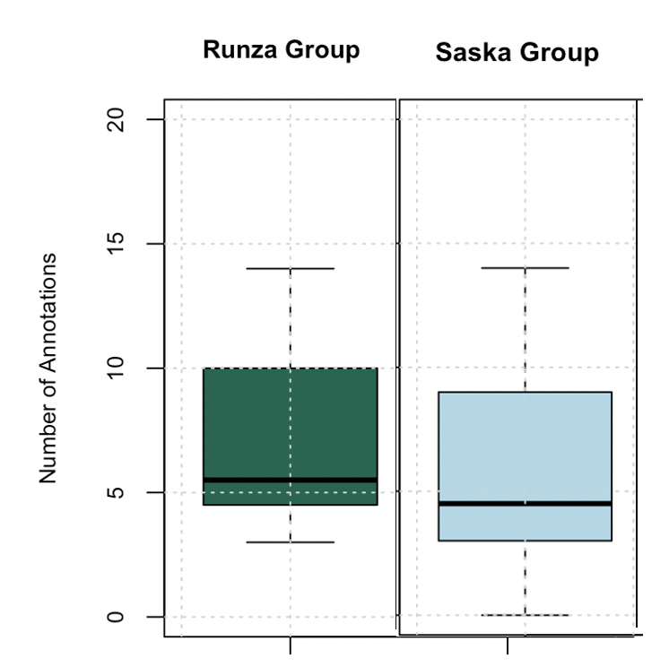
FINDINGS > Ethnicity impact on number of comments

Slide 41
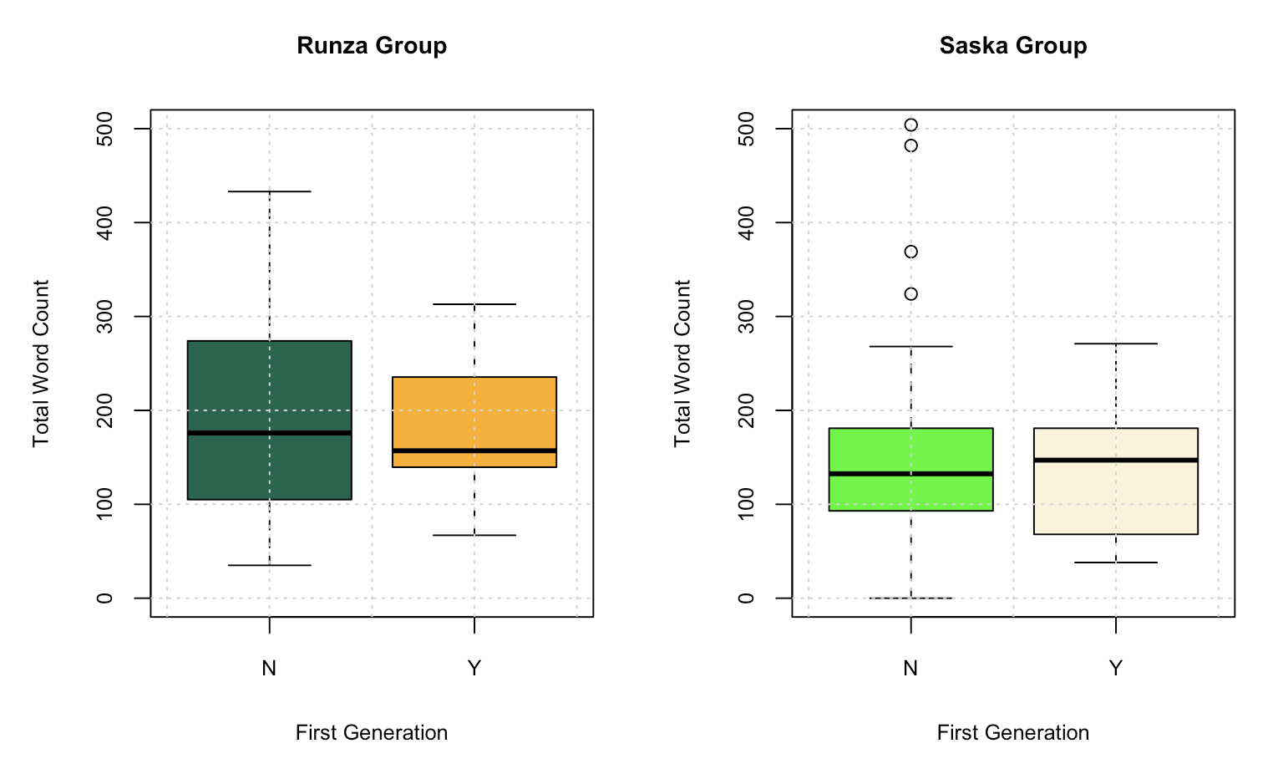
FINDINGS > First Generation impact on word count

Slide 42
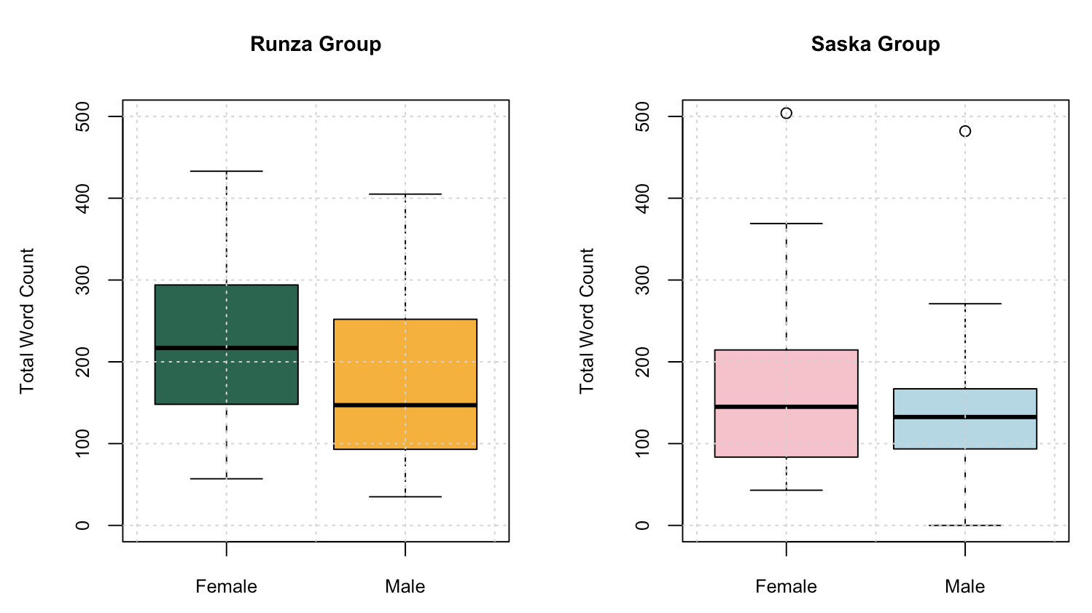
FINDINGS > Gender impact on word count

Slide 43
CONCLUSIONS

Slide 44
STUDY SUGGESTS
Our students will benefit from more case studies about high-equity Nebraska-based companies.
More study is needed.
Larger sample size
Tease out the impact of awareness, localness
Strategies to further engagement

Slide 45
QUESTIONS?

Slide 46
